Slide 1


MODIS-GOES Hybrid
Sixth Meeting of the Science Advisory Committee
28 February - 1 March, 2012
National Space Science and Technology Center, Huntsville, AL
transitioning unique NASA data and research technologies to operations

Slide 2
Background
GOES animations are second nature to forecasters
MODIS data are higher resolution, but infrequent
Forecasters would say:
  “The data aren’t here when I need them”
  “I would use the data if I could loop the images”
Let’s combine the best of both worlds

Slide 3
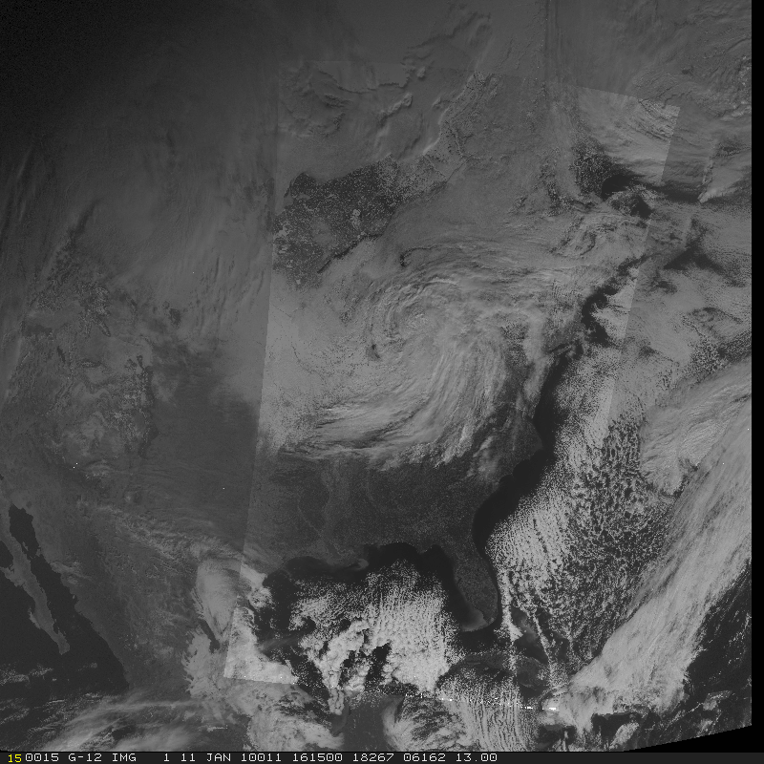
MODIS-GOES Hybrid Visible

Slide 4
Relevance to SPoRT
GOES-R Proving Ground
  Preparation for Advanced Baseline Imager (ABI)
    500 m resolution visible channel
    2 km resolution infrared channels
Forecasters can begin to become accustomed to higher resolution imagery
  GOES-R ABI will be a whole new paradigm
Awareness of present weather conditions will improve nowcasting and short-term forecasts.

Slide 5
Accomplishments since SAC 2009
Training completed in April 2010
User Survey completed in May 2011
Currently 13 WFOs receiving products
  6 receiving highest-res version
    BMX, HUN, JSC, LIX, MFL, MOB
  8 receiving ABI-res version
    ABQ, CRP, HGX, HUN, JAN, MLB, MRX, OHX
Blog posts report successes at WFOs

Slide 6
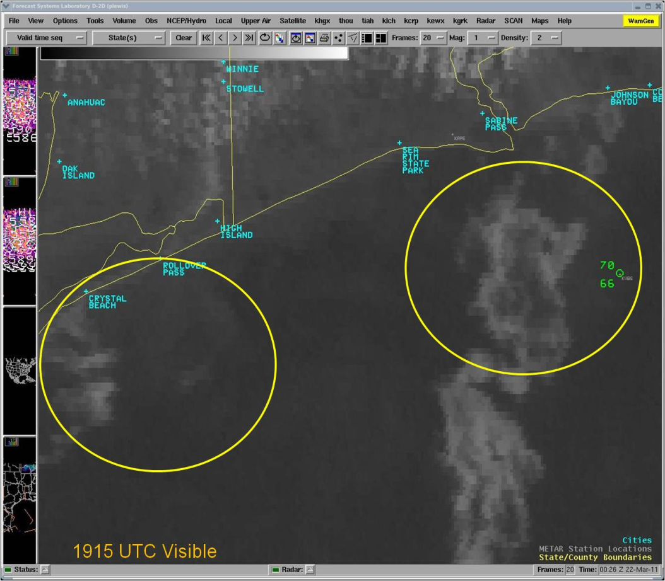
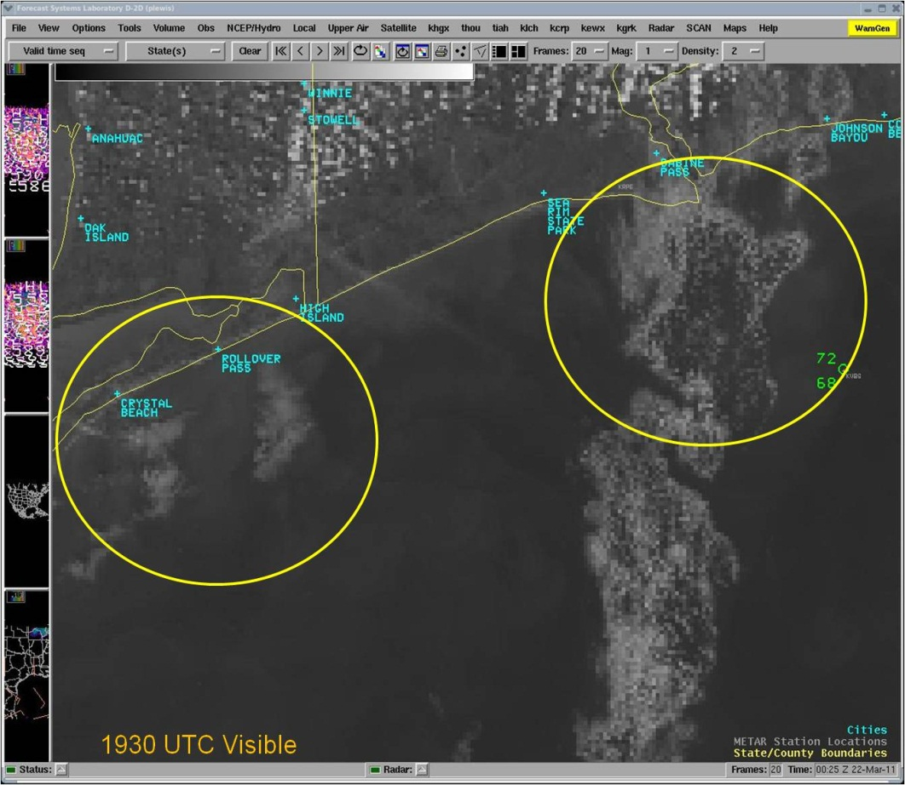
MODIS-GOES Hybrid Visible product
Lance Wood (HOU)
“The high resolution 1930Z MODIS image revealed that convective cloud elements were present, as opposed to the more laminar look of stratus and/or sea fog that the lower resolution GOES products at 1915Z and 1945Z depicted.”
1915 GOES Visible
1930 MODIS Visible

Slide 7
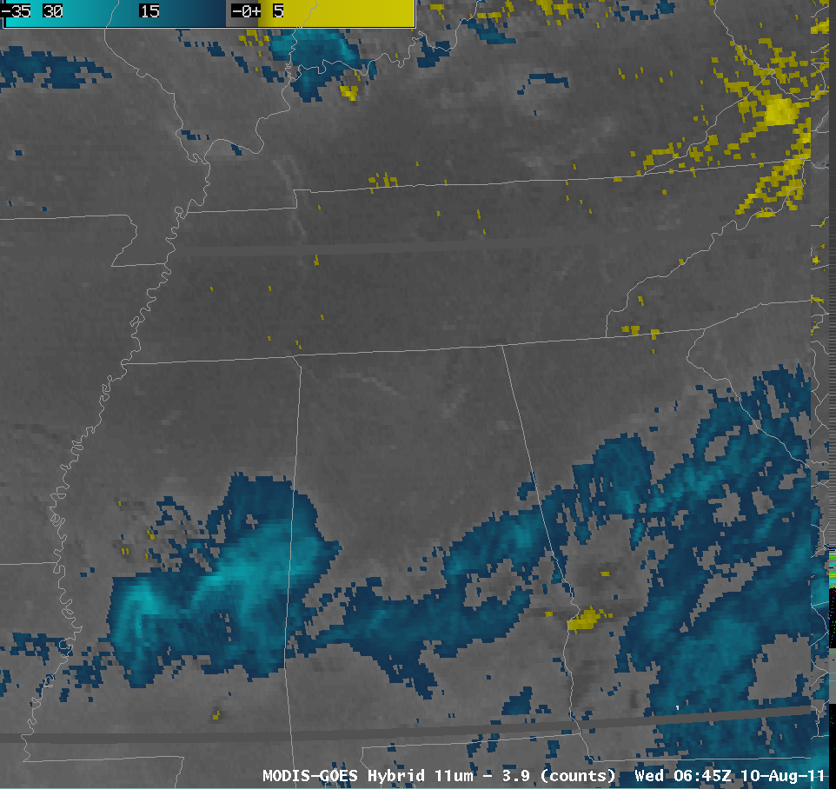
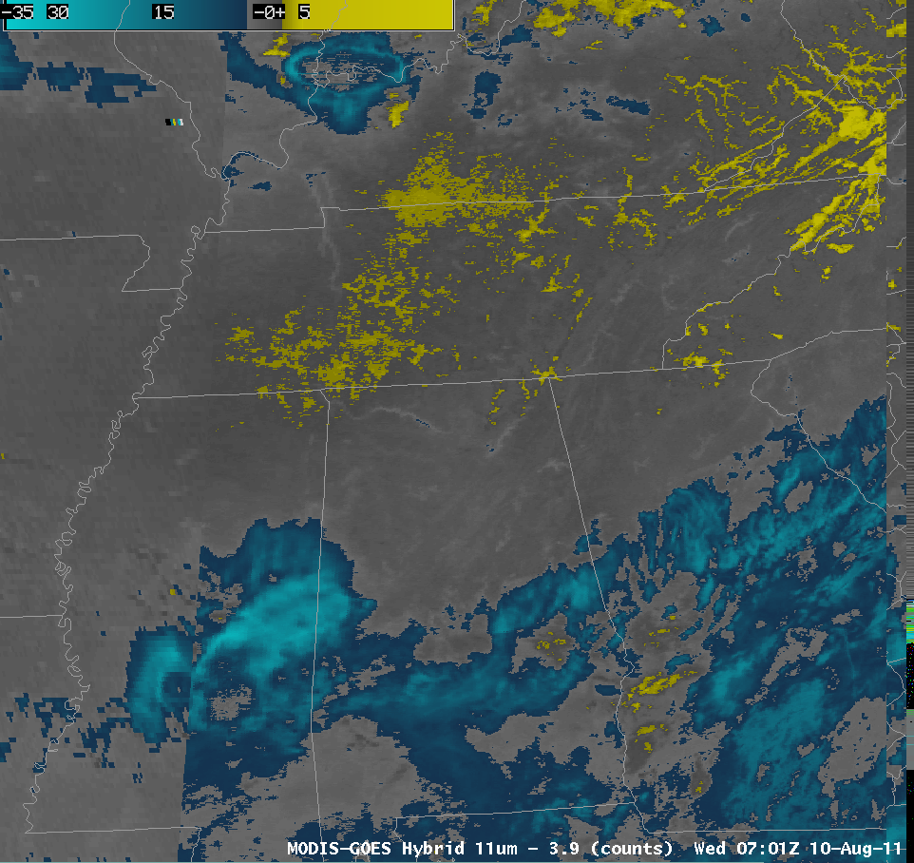
MODIS-GOES Hybrid Fog product
Kris White (HUN)
“The early detection of this fog can be pivotal is assessing its eventual intensity and coverage. The MODIS-GOES hybrid 11um-3.9 product early yesterday morning showed the usefulness of the MODIS imagery…”
0645 GOES Spec. Diff.
0701 MODIS Spec. Diff.

Slide 8
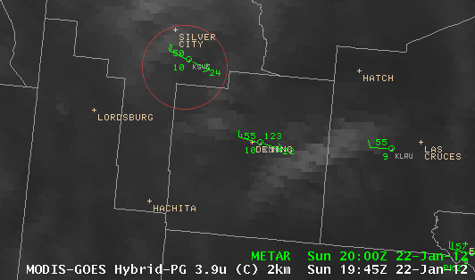
MODIS-GOES Hybrid Shortwave product
Brian Guyer (ABQ)
-“…at 1945Z (1245 pm MST) … no hot spot is evident.
-“…MODIS image …from 2002Z – a hot spot likely associated with the fire is depicted in the 2km resolution (image).”
-“The hot spot is not readily identifiable in the GOES imagery until 2032Z, and even at that time the signal is subtle.”

Slide 9
Hybrid Resolutions (km)
G-RPG
(ABI)
GOES
NASA
Visible 1 0.5 0.25
IR (SW) 4 2 1
IR (LW) 4 2 1
Water Vapor 4 2 1
Fog 4 2 1

Slide 10
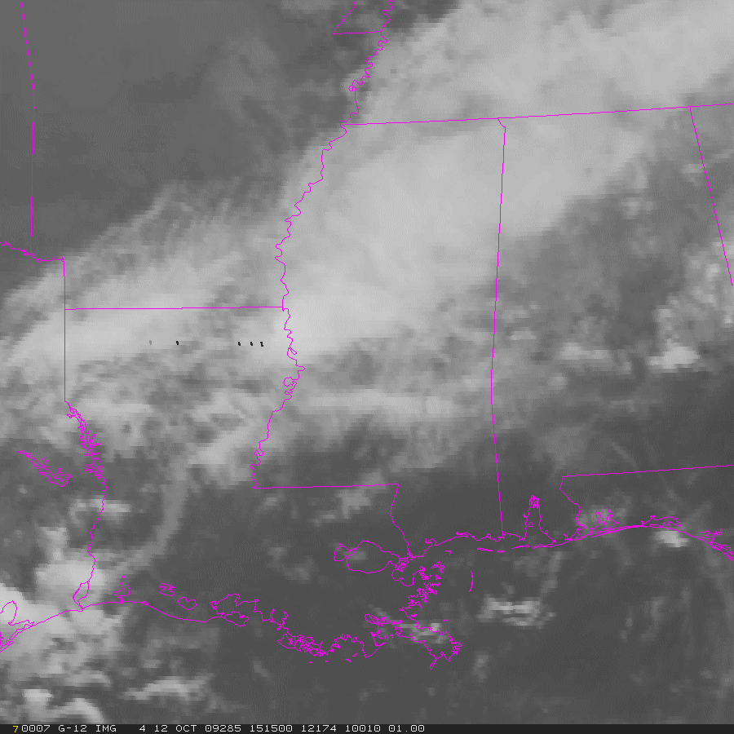

MODIS-GOES Hybrid IR loop

Slide 11
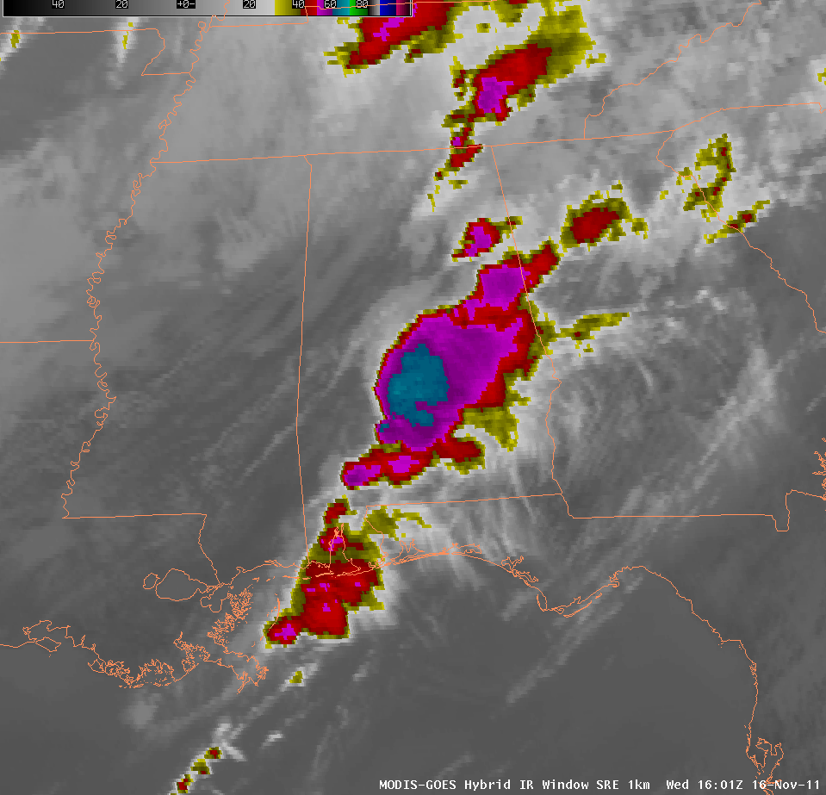
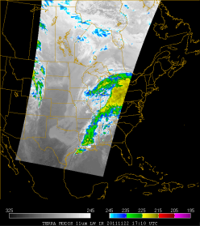
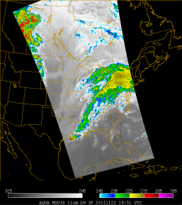
Method
1800
1815
1830
1845
1900
1915
1930
Time
GOES-E
GOES-E
GOES-E
GOES-E
GOES-E
GOES-E
1745
1815
1830
1845
1900
1915
GOES-W
1800
1753
1841
MODIS Terra (Desc)
MODIS Aqua (Asc)

Slide 12
Future Work
Incorporate VIIRS data (new name)
Add product domains for
  Alaska Region
  Pacific Region
Make atmospheric corrections for
  Parallax
  Limb Effects
Investigate AWIPS II capabilities
Incorporate RGB Products
  MODIS Airmass -> GOES Water Vapor
  MODIS Nighttime Microphysics -> GOES Fog
  MODIS True Color -> GOES Visible
  MODIS Dust -> GOES Visible

Slide 13
Questions ?

Slide 14
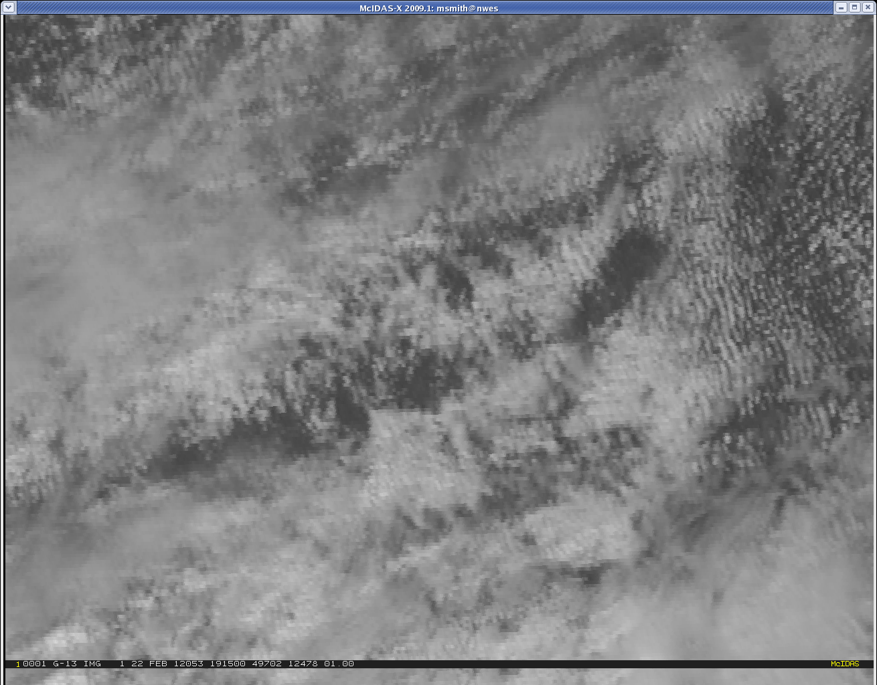
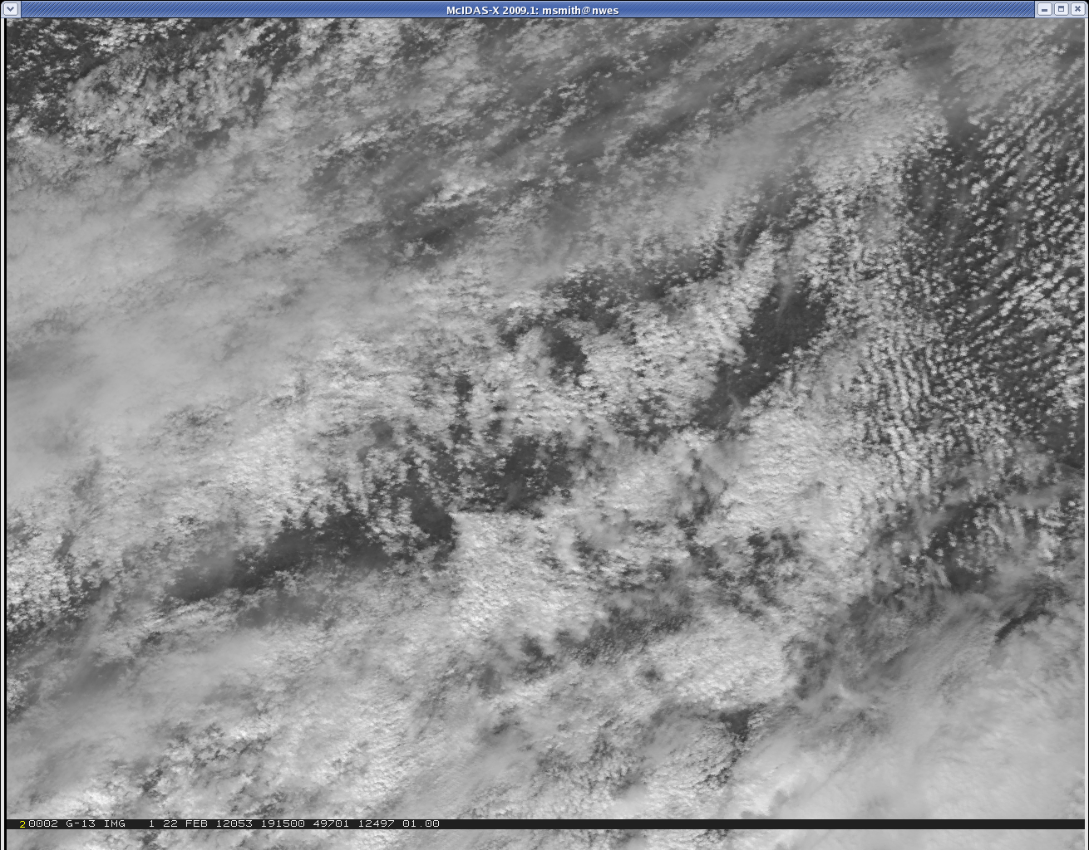
MODIS/GOES Hybrid Visible

